Slide 1

Professor David Flynn
Catch All- EN2083

Slide 2
catch all
ongoing bits and pieces 🙂

Slide 3
bitwise operations
colloquially referred to as bit bashing

Slide 4
Reminder, conversions
everything is ultimately binary, but we assume integers which we can display in binary or hex :
  x = int('01101010',2) # binary string to int
  print(x)
  print('dec {0} bin {0:b} hex {0:x}'.format(x))
  # dec 106 bin 1101010 hex 6a
no idea if this is stored as 8 bits, 16 bits, or a more complex object (probably the latter)
Notes:
do a test of the boundary conditions on the loop

Slide 5
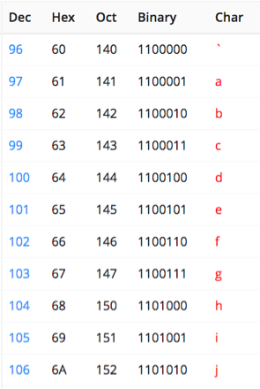
single ascii characters
it is possible to consider a small (8 bit) integer as an ascii character :
  x = int('01101010',2)
  print(x)
  print(chr(x))
  # decimal 106 character 'j'
and the other way around
  x = ord('j')
  print(x)
  # 106
(ord(), unichar() for Unicode)
Notes:
do a test of the boundary conditions on the loop

Slide 6
bitwise operators
Python has operators for logical bit-operations which can be applied to integers. For example,
y = x & 0177
forms the bit-wise AND of x and 0177, effectively retaining only the last seven bits of x in y. (0177 = 001 111 111)

Slide 7
Other operators include
| bitor inclusive OR
^ xor (circumflex) exclusive OR
~ compl (tilde) 1's complement
! not logical NOT
<< left shift (as in x<<2)
>> right shift

Slide 8
examples :
a = 60 # 60 = 0011 1100 b = 13 # 13 = 0000 1101
c = a & b; # 12 = 0000 1100
c = a | b; # 61 = 0011 1101
c = a ^ b; # 49 = 0011 0001
c = ~a; # -61 = 1100 0011
c = a << 2; # 240 = 1111 0000
c = a >> 2; # 15 = 0000 1111

Slide 9
Masking
you very commonly want to set, clear to flip a single bit in a binary value :
  # returns integer with bit at 'offset' set to 1.
  def setBit(int_type, offset):
    mask = 1 << offset
    return(int_type | mask)
  # returns integer with the bit at 'offset' cleared.
  def clearBit(int_type, offset):
  mask = ~(1 << offset) # note inversion
  return(int_type & mask)
  # returns integer with the bit at 'offset' inverted.
  def toggleBit(int_type, offset):
  mask = 1 << offset
  return(int_type ^ mask)
Notes:
do a test of the boundary conditions on the loop

Slide 10
Complex bit bashing
but rotating bits is harder, because you don't know how many bits are actually stored in your variable:
# Rotate left: 0b1001 --> 0b0011 by r but in 16 bits
  rol = (val << r%16) & (2**16-1) | \
  ((val & (2**16-1)) >> (16-(r%16)))
# Rotate right: 0b1001 --> 0b1100 by r in 16 bits
  ror = ((val & (2**16-1)) >> r%16) | \
    (val << (16-(r%16)) & (2**16-1))
ouch - let's look a bit more closely
Notes:
do a test of the boundary conditions on the loop

Slide 11

Bitwise rotate left by 3 - considering high order bits
x x x x
0 | 0 | 1 | 1 | 1 | 1 | 0 | 0 | 1 | 0 | 1 | 0 | 1 | 0 | 1 | 0
val
0 0 0 0
1 | 1 | 1 | 1 | 1 | 1 | 1 | 1 | 1 | 1 | 1 | 1 | 1 | 1 | 1 | 1
2**16-1
... x3...
x 0 0 1
1 | 1 | 1 | 0 | 0 | 1 | 0 | 1 | 0 | 1 | 0 | 1 | 0 | 0 | 0 | 0
val<<3%16
0 0 0 0
1 | 1 | 1 | 0 | 0 | 1 | 0 | 1 | 0 | 1 | 0 | 1 | 0 | 0 | 0 | 0
⇧ & 2**16-1
0 0 0 0
0 | 0 | 1 | 1 | 1 | 1 | 0 | 0 | 1 | 0 | 1 | 0 | 1 | 0 | 1 | 0
val & 2**16-1
... x13...
0 0 0 0
0 | 0 | 1 | 1 | 1 | 1 | 0 | 0 | 1 | 0 | 1 | 0 | 1 | 0 | 0 | 1
⇧ >>(16-3)
higher
bits
... finally combine by bitwise or...
1 | 1 | 1 | 0 | 0 | 1 | 0 | 1 | 0 | 1 | 0 | 1 | 0 | 0 | 0 | 1

Slide 12
interfacing with reality
to link to real hardware, usually use ctypes:
# import ctypes
c_uint8 = ctypes.c_uint8
class Flags_bits( ctypes.LittleEndianStructure ):
_fields_ = [
("logout", c_uint8, 1 ), # asByte & 1
("userswitch", c_uint8, 1 ), # asByte & 2
("suspend", c_uint8, 1 ), # asByte & 4
("idle", c_uint8, 1 ), # asByte & 8
]
class Flags( ctypes.Union ):
_anonymous_ = ("bit",)
_fields_ = [
("bit", Flags_bits ),
("asByte", c_uint8 )
]
flags = Flags()
flags.asByte = 0x2 # ->0010
print( "logout: %i" % flags.bit.logout )
# `bit` is defined as anonymous field, so its fields can also be accessed directly:
print( "logout: %i" % flags.logout )
print( "userswitch: %i" % flags.userswitch )
print( "suspend : %i" % flags.suspend )
print( "idle : %i" % flags.idle )ouch - let's look a bit more closely
Notes:
do a test of the boundary conditions on the loop

Slide 13
interfacing with reality
ctypes can match fixed bit length variables one to another.
flags = Flags()
flags.asByte = 0x2 # ->0010
print( "logout: {}".format(flags.bit.logout))
print( "logout: {}".format(flags.logout ))
print( "userswitch: {}".format(flags.userswitch))
print( "suspend : {}".format(flags.suspend ))
print( "idle : {}".format(flags.idle ))
      logout: 0
      logout: 0
      userswitch: 1
      suspend : 0
      idle : 0
Notes:
do a test of the boundary conditions on the loop

Slide 14
Advanced Plotting
practical advice with plotting package

Slide 15
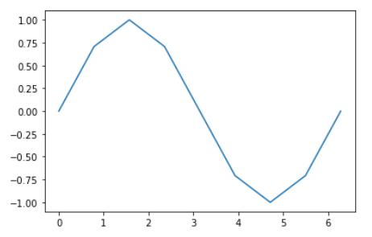
Plotting with np arrays
reminder of how to do plotting with numpy arrays and the matplotlib library:
  import numpy as np
  import matplotlib.pyplot as ppt
  pi = np.pi
  xvals = np.linspace(0.0, 2*pi, 9)
  yvals = np.sin(xvals)
  ppt.plot(xvals, yvals)
create an array of x-coords.
calculate the y-coords.
plot.
Notes:
do a test of the boundary conditions on the loop

Slide 16
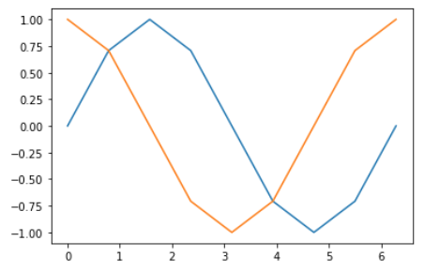
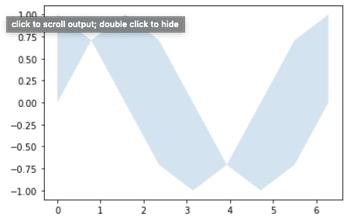
Multiple plots
plotting two traces with same x-coord, plots on the same plot:
  pi = np.pi
  xvals = np.linspace(0.0, 2*pi, 9)
  yvals = np.sin(xvals)
  yvals2 = np.cos(xvals)
  ppt.plot(xvals, yvals)
  ppt.plot(xvals, yvals2)
oh, and can fill between traces :
  yvals = np.sin(xvals)
  yvals2 = np.cos(xvals)
  ppt.fill_between(xvals, yvals, yvals2,
  alpha=0.2)
Notes:
do a test of the boundary conditions on the loop

Slide 17
multiple separate plots
plotting two traces side by side needs the ppt.subplot() function (I know you've had a go at using this in the labs):
  fig, axarr = plt.subplots(2, 1, sharex=True)
  # figure has rows = 2 and columns = 1 of graphs
it returns a figure object and a tuple of axes or graphs into which you can drop data:
  axarr[0].scatter(x_vals, squares) #row 1 col 1
  axarr[0].set_title('Squares')
  axarr[1].scatter(x_vals, cubes, c='r') #row 1 col 2
  axarr[1].set_title('Cubes')
Notes:
do a test of the boundary conditions on the loop

Slide 18
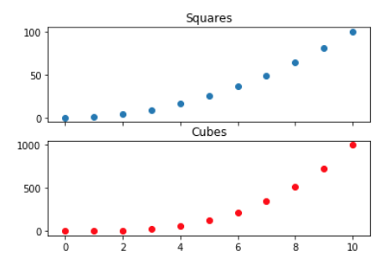
multiple separate plots
we can plot with a shared x-axis :
  fig, axarr = plt.subplots(2, 1, sharex=True)
Notes:
do a test of the boundary conditions on the loop

Slide 19
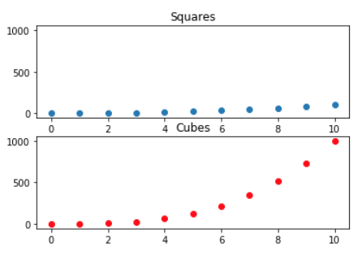
multiple separate plots
or we can plot with shared y-axis :
  fig, axarr = plt.subplots(2, 1, sharey=True)
Notes:
do a test of the boundary conditions on the loop

Slide 20
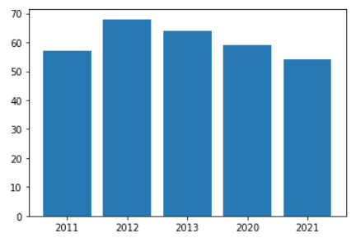
Plots with dates/times
sometimes you want to plot against year, date or time - lines or bar charts.
could just list dates as strings:
  years = ['2011', '2012', '2013', '2020', '2021']
  highs = [57, 68, 64, 59, 54]
but then plotting would
just 'bunce' them all
together with no proper
separation
Notes:
do a test of the boundary conditions on the loop

Slide 21
dates/times
datetime module is helpful,
  from datetime import datetime as dt
  #create datetime objects
  today = dt.now()
  new_year = dt(2020, 1, 1)
  equinox = dt(year=2020, month=3, day=20)
  # convert string to datetime object
  new_years = dt.strptime('1/1/2020', '%m/%d/%Y')
  # convert datetime object to string
  ny_string = dt.strftime(new_years, '%B %d, %Y')
as Python can now tell the 'distance' between dates.
Notes:
do a test of the boundary conditions on the loop

Slide 22
dates/times
oh, date/time formatting info:
  %A Weekday name, such as Monday
  %B Month name, such as January
  %m Month, as a number (01 to 12)
  %d Day of the month, as a number (01 to 31)
  %Y Four-digit year, such as 2016
  %y Two-digit year, such as 16
  %H Hour, in 24-hour format (00 to 23)
  %I Hour, in 12-hour format (01 to 12)
  %p AM or PM
  %M Minutes (00 to 59)
  %S Seconds (00 to 61)
used for " I'd like to format like this "
Notes:
do a test of the boundary conditions on the loop

Slide 23
Example
load libraries and get a short list of dates and maximum temperature values,
  from datetime import datetime as dt
  import matplotlib.pyplot as ppt
  from matplotlib import dates as mdates
  dates = [
  dt(2016, 6, 21), dt(2016, 6, 22),
  dt(2016, 6, 23), dt(2016, 6, 26),
  ]
  highs = [17, 15, 11, 18]
now we can think about plotting this
Notes:
do a test of the boundary conditions on the loop

Slide 24
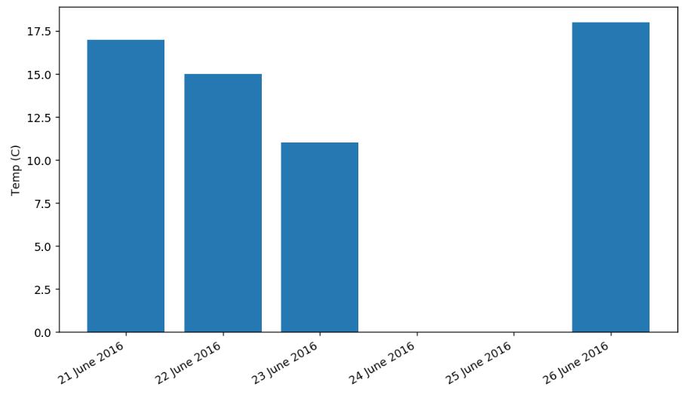
Example
a little work needs
done for the x-axis
fig = plt.figure()
ppt.bar(dates, highs)
ppt.ylabel("Temp (C)")
x = plt.axes().get_xaxis()
x.set_major_formatter(mdates.DateFormatter('%d %B %Y') )
fig.autofmt_xdate()
ppt.show()
but the result spans properly.
Notes:
do a test of the boundary conditions on the loop

Slide 25
Discontinuous plots
some functions are inherently discontinuous, and that's tricky.
for instance, the bending moment of a simply supported beam with point load in the middle is a 'V' shaped plot.
  def bendingMoment(x, length, load):
  if x <= length/2:
  return -x * load / 2
  else:
  return -(length-x) * load / 2
Notes:
do a test of the boundary conditions on the loop

Slide 26
Discontinuous plots
plotting this will give an error,
  length, load = 10, 2
  xvals = np.arange(0, length, 0.01)
  yvals = bendingMoment(xvals, length, load)
because whilst numpy arrays allow element by element calculation, they baulk when you try and do an if on the array.
there is a neat trick to fix the function
  bmVec = np.vectorize(bendingMoment)
Notes:
do a test of the boundary conditions on the loop

Slide 27
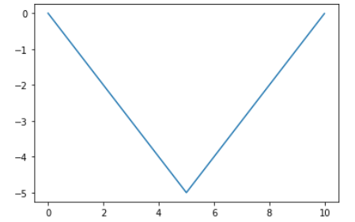
discontinuous plots
then,
  length, load = 10, 2
  xvals = np.arange(0, length, 0.01)
  bmVec = np.vectorize(bendingMoment)
  yvals = bmVec(xvals, length, load)
and everything is good.
  ppt.plot(xvals,yvals)
Notes:
do a test of the boundary conditions on the loop

Slide 28
Advanced Lists
'comprehensions'
useful list shortcuts to make your code simpler

Slide 29
comprehensions
comprehensions - a short way to make lists
brackets containing an expression, a for clause, then zero or more for / if clauses
You can put in all kinds of objects in lists using comprehensions.
The list comes from evaluating the expression in context of the for / if s

Slide 30
as usual, example best
if you previously did this:
  new_list = []
  for i in old_list:
  if filter(i):
  new_list.append(expression(i))
you now do this:
  new_list = [expression(i) for i in old_list \
  if filter(i)]
  # square brackets remind you that this is a list

Slide 31
as usual, example best
if you previously did this:
  new_list = []
  for i in old_list:
  if filter(i):
  new_list.append(expression(i))
you now do this:
  new_list = [expression(i) for i in old_list \
  if filter(i)]
  # square brackets remind you that this is a list

Slide 32
specific examples
nine numbers from a range:
  x = [i for i in range(10)]
  # x is [0, 1, 2, 3, 4, 5, 6, 7, 8, 9]
squares from a range:
  x = [i**2 for i in range(10)]
  # x is [0, 1, 4, 9, 16, 25, 36, 49, 64, 81]
strings from an existing list:
  x = [x.lower() for x in ["A","B","C"]]
  # x is ['a', 'b',,'c']

Slide 33
more specific examples
pre-existing items, with conditional:
  string = "Hello 12345 World"
  numbers = [x for x in string if x.isdigit()]]
  # numbers is ['1', '2', '3', '4', '5']
if you have a text file file:
  result = [i for i in file if "line3" in i]
  # result is list of lines containing 'line3'
multiple arguments:
  res = [x+y for x in [10,30,50] for y in [20,40,60]]
  # res is [30, 50, 70, 50, 70, 90, 70, 90, 110]

Slide 34
Advanced File I/O
practical advice on working with files

Slide 35
files
files are tricky.
what happens if something goes wrong with the disk half way through a write, or if the file that you reading doesn't quite exist?
Python has a try-except block for just this sort of thing:
  try:
  print(5/0)
  except ZeroDivisionError :
  print("You cannot divide by zero")
  #the 'exception' here is a ZeroDivisionError
Notes:
do a test of the boundary conditions on the loop

Slide 36
files
or perhaps more comprehensively, a try-except-else block:
  filename = 'test.txt':
  try:
  with open(filename) as f
  lines = f.readlines()
  except FileNotFoundError :
  print("Can't find file {}".format(filename))
  print(msg)
  # the exception here is FileNotFoundError
  else:
  print("Will process {}".format(filename))
find the specific error code, by actually making the error yourself once 🙂
Notes:
do a test of the boundary conditions on the loop

Slide 37
files
here's a practical use - report file length:
  f = ['hhgttg.txt','lotr.txt','hpatps.txt', 'aocp.txt']
  for filename in f:
  try:
  with open(filename) as f_obj:
  lines = f_obj.readlines()
  except FileNotFoundError:
  pass # Just move on to the next file.
  else:
  num = len(lines)
  msg = "{0} has {1} lines.".format( filename, num)
  print(msg)
note the pass; deals with the problem silently
Notes:
do a test of the boundary conditions on the loop

Slide 38
Exceptions
it is possible to catch all exceptions:
  try:
  # stuff
  except:
  pass # catch everything !
but that will catch all sorts of stuff like keyboard interrupts and probably utterly lock up your machine - so don't !
if needed, this will catch most useful Exceptions.
  except Exception as e:
  print(e, type(e))
Notes:
do a test of the boundary conditions on the loop

Slide 39
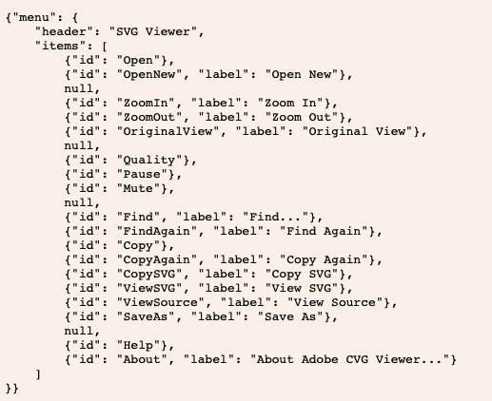
JSON
JavaScript Object Notation (JSON) is a lightweight data-interchange format. i.e. a simple way of writing text files to store data in a structured way.
It's commonly used, and useful for sharing data with people across programming languages.
Of course Python has JSON libraries.
  import json
Notes:
do a test of the boundary conditions on the loop

Slide 40
C / C++ from Python
once you've got Python, you've pretty much got C

Slide 41
Important differences
indenting & statement delimiters
overall code structure
input/output statements
declaration of variables
for loops - no ranges or easy lists
complex types tougher to set up
pointers

Slide 42
statements / indenting
indentation in Python is necessary;
in C it is simply good form, but do it!
C needs {
  end of statement character ';'
  compound statement braces '{' '}'
  comments as '//', or '/*' and '*/'
  }

Slide 43
Statements / indenting
an example of something you've seen; in C
    /* input, sum and count the quiz grades */
    printf(“Enter grade, -1 to end: “);
    scanf(“%d”, &grade); // input first grade
    while(grade != -1) { // while not ‘halt’
        total += grade; // add to total
        counter++; // increment counter
        printf(“Enter grade, -1 to end: “);
        scanf(“%d”, &grade); // input next grade
    }

Slide 44
Overall structure
programs in Python or C consist of:
  importing libraries
  definition of supporting functions
  main program
in C, the main program is a function called, surprisingly, main.

Slide 45
code structure in C
two approaches to structure :
    #include <stdio.h> // import library !
    int powr(int base, int n) { // define function
      int i, p=1; // inputs
      for (i=1; i<=n, i++) p=p*base;
      return p;
    }
    int main() { // the main function or program
      int i;
      for (i=0; i<20; i++) {
        printf(“%d %d %d\n”, i,powr(3,i),powr(4,i));
      }
    }

Slide 46
Code structure in C
or :
    #include <stdio.h> // import library !
    int powr(int, int); // flag function in advance
    int main() { // the main function or program
      int i;
      for (i=0; i<20; i++) {
        printf(“%d %d %d\n”, i,powr(3,i),powr(4,i));
      }
    }
    int powr(int base, int n) { //define it later
      int i, p=1;
      for (i=1; i<=n, i++) p=p*base;
      return p;
    }

Slide 47
formatting output
formatting output is always clunky, but where python uses {}, C uses % :
    print("{} {} {}".format(i, powr(3,i),powr(4,i)))
    # printing with formatting in Python
    printf(“%d %d %d\n”, i, powr(3,i), powr(4,i));
    //printing with formatting in C
    // %<width>.<digits_after_point><type>
    //
    // where <type> is d for integer/decimal
    // f for float
    // e for engineering format

Slide 48
getting input
for inputs, C uses % formatting just like for outputs, but it's a bit of a pain:
    s = input("input please")
    s = int(s)
    # input in Python of a decimal / integer
    scanf(“%d”, &s);
    // input in C of a decimal / integer
    // advantage is that scanf automatically converts,
    // disadvantage is that everything else about
    // input in C is horrid

Slide 49
declaring variables
here is a huge difference between Python and 'lesser' languages in functionality.
Python does all the work for you; you use variables and it works out their type.
C needs you to explicitly describe what something is, in advance, in detail, so that the compiler can set aside memory

Slide 50
declaring variables in C
Need to declare variables, at the beginning of the block in which they are used.
Declaration valid within that block
Form <type> <variablename>
Common types int float char (8-bit) double long short
i.e. int i = 0; memory is reserved for an integer called ‘i’, updated to value 0.

Slide 51
example declarations
note: three variables declared before use
#include <stdio.h>
int main () {
int integer_size; // in python, you could have
int character_size; // assumed the compiler would
int float_size; // get this done for you
  integer_size = sizeof(int);
character_size = sizeof(char);
float_size = sizeof(float);
  printf("int, char, float use %d %d and %d bytes\n",
integer_size, character_size, float_size);
  return 0;
}

Slide 52
loops, loops, loops
while loops are pretty much like Python
    while (counter<n) {
      value = 2*value; //or value *= 2;
      printf(“current value is %d\n”,value);
      counter++;
    }
C also has do-while loops with check at end
        do {
            prevGuess = currGuess;
            currGuess = (prevGuess + n/prevGuess)/2;
        } while (fabs(prevGuess-currGuess)>error;

Slide 53
loops, loops, loops
the big difference is in counting loops, with C having a 'classic' counting loop
for (<ex1>;<ex2>;<ex3>) <statement>
ex1 initialises a loop counter.
we evaluate ex2, and exit the loop if false.
if ex2 true, the computer executes the statement and then ex3 and then goes back to check the ex2 again.

Slide 54
for
powers of 2 python example now in C:
    #include <stdio.h>
    int main() {
        int n, counter = 0, value = 1;
        scanf(“value for n: %d”, &n);
        for (counter=0; counter<=n; counter++) {
            if (counter==0) printf(“value is 1”);
            else {
              value *= 2;
              printf(“value is %d\n”,value);
            }
        }
    }
Notes:
do a test of the boundary conditions on the loop

Slide 55
complex types - array
C doesn't have tuples, lists or dictionaries, where you can store heterogeneous arrays of stuff of all sorts.
It does have arrays.
Can have multiple dimensions, but in 1-D is an indexed list of items of the same type.
Declare as <type> <name>[#] where the [] indicates an array, and the # is the number of elements.

Slide 56
Array declaration
so as some specific examples :
    float distances[100];
    int marks[7] = {32,56,76,104,6,12,18};
    char name[5] = {‘m’,’i’,’k’,’e’,’\0’};
    char text[5] = “mike”;
usage :
    distances[0] = 12.0;
    distances[99] = 47.34;
    distances[100] = 1.2; // error!
    a = marks[3] // a=104
    char t = name[1] // t=’i’
    char t = text[1] // t=’i’
marks
0 | 32
1 | 56
2 | 76
3 | 104
4 | 6
5 | 12
6 | 18

Slide 57
example
compute the average of 5 numbers :
    #include <stdio.h>
    int main( ){
      int numbers[5] = {1,3,2,6,-5};
      int sum = 0, i;
      float average;
      for ( i = 0; i < 5; i++) {
        sum = sum + numbers[i];
      }
      average = (float) sum/5;
      printf(“Average is: %f”, average);
      return 0;
    }
just like numerical lists in Python - but you have to do the counting explicitly.
Notes:
Idea of functions hiding previous work to simplify code should be introduced here.

Slide 58

Multiple Dimensions
Arrays with more than one dimension can be defined in the following way :
int myArray[4][3] int myArray[2][4][3]
 | 0 | 1 | 2
0
1
2
3
0 | 0 | 1 | 2
0
1
2
3
1 | 0 | 1 | 2
0
1
2
3

Slide 59
Two Dimensions
Arrays with more than one dimension can be defined in the following way :
  int myArray[4][3] // declare 4 rows and 3 columns
  x = myArray[i][j] // element from ith row, jth col
 | 0 | 1 | 2
0
1
2
3
Remember to count from 0
Storage in C is row-major ordering; store row 0, then row 1, etc.

Slide 60
strings in C
Recall a couple of slides back
char name[5] = {‘m’,’i’,’k’,’e’,’\0’};
char text[5] = “mike”;
A string variable is simply an array of 8-bit ascii characters.
We can print a string in C without needing to specify the total number of characters because the string stores a ‘\0’ in an array element as an ‘end of string’ character.

Slide 61
complex types - struct
You can have heterogenous data in C - you use a struct.
structs are a bit like objects with all the functions stripped out, or like clunky lists.
you have to first set up the 'type' (i.e. say what the contents of a given structure would look like.
Then you can create a variable of that type

Slide 62
declare & initialise
struct lib_books {
char title[20];
char author[15];
int pages;
float price;
}
struct lib_books book1 = {“concretemathematics”, “Graham”, 625}
// book1 is the thing, and this gives
// its initial contents

Slide 63
common declare trick
typedef struct {
char title[20];
char author[15];
int pages;
float price;
} Book;
// alias the definition with name Book
Book book1, book2;
// so this declares two actual structs
// both of type Book
// looks neater, and a bit like objects

Slide 64
accessing data by ‘dot’
int main()
{
Book b;
b.author = "John Smith";
b.pages = 25;
printf("%s",b.author);
printf("%d",b.pages);
return 0;
}
// reminds you of object functions in
// Python, which is where the idea to
// came from

Slide 65
or by ‘->’
int main()
{
Book b;
Book *bookPtr;
bookPtr = &b;
bookPtr->author = "John Smith";
bookPtr->pages = 25;
printf("%s",bookPtr->author);
printf("%d",bookPtr->pages);
}
// C programmers love pointers (later!)
ok, better talk about pointers...

Slide 66
pointers
in C, if a variable number is declared and given a value, 5 say, then printing number prints 5.
however, the value of &number is the memory location where that 5 is stored.
and you can declare a variable num_ptr, which can store this address
int* num_ptr = &number
// read as "num_ptr is a pointer to an integer"

Slide 67
pointers
this is an easy idea for computer designers, because they are always thinking about the addresses of locations in memory.
however, for the rest of us, no point, but...
C functions make copies of incoming arguements; originals don't change - and only one thing returned. How d'you return more than one thing? (Lists, tuples, structures hadn't been invented)

Slide 68
pointers
neat hack.
don't send a variable to a function, send the pointer to it instead.
If the function knows that memory location of a variable, it can just sneakily go and alter it!
(C programmers though that this was a terribly good idea)

Slide 69
Before main calls cubeByReference
main ( )
{
int number = 5;
cubeByReference(&number);
}
void cubeByReference(int *nPtr)
{
*nPtr = *nPtr * *nPtr * *nPtr;
}
number
5
nPtr
??

Slide 70
After main calls cubeByReference but before cubing
main ( )
{
int number = 5;
cubeByReference(&number);
}
void cubeByReference(int *nPtr)
{
*nPtr = *nPtr * *nPtr * *nPtr;
}
number
5
nPtr

Slide 71
After cubing
main ( )
{
int number = 5;
cubeByReference(&number);
}
void cubeByReference(int *nPtr)
{
*nPtr = *nPtr * *nPtr * *nPtr;
}
number
125
nPtr

Slide 72
After the completed function call
main ( )
{
int number = 5;
cubeByReference(&number);
}
void cubeByReference(int *nPtr)
{
*nPtr = *nPtr * *nPtr * *nPtr;
}
number
125
nPtr
??

Slide 73
pointers
hence there are many mind-twisting bits of C code in the world using pointer passing to do neat coding tricks.
  (for example, in C the name of a string is a pointer to it's first element - so you can pass a string to a function and change it)
Pointers are how Python does some of its cool things - but Python just does the cool things, rather than displaying its entrails!

Slide 74
Matlab from Python
once you've got Python, you've pretty much got Matlab

Slide 75
I'm not a Matlab expert. Maybe Jim could write a few decent slides here.
But not yet needed for the E&EE student body.

Slide 76



Thank you
#UofGWorldChangers
@UofGlasgow

